Slide 1
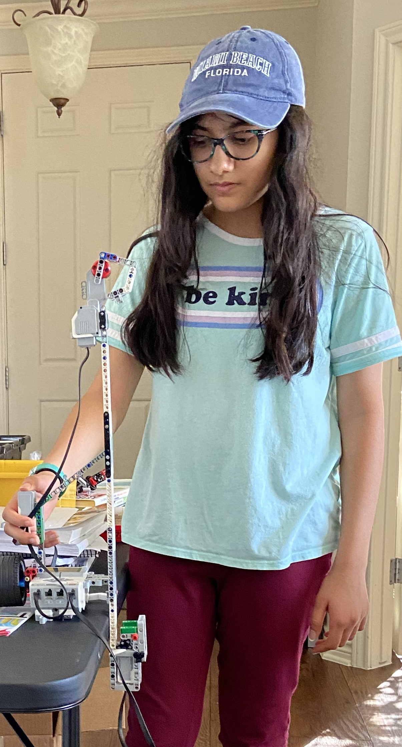
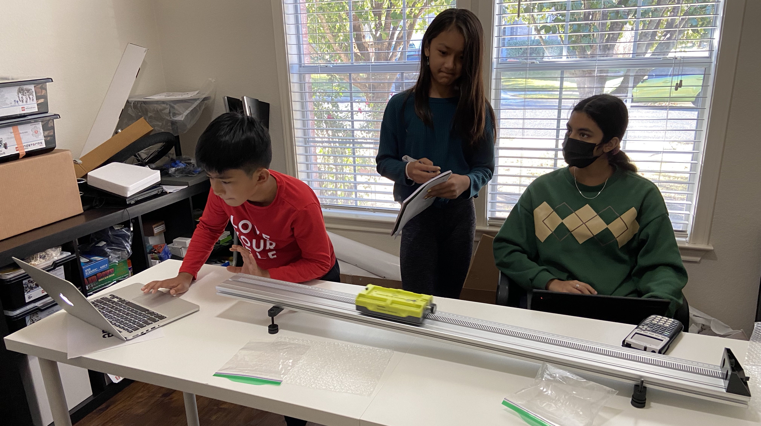
Cushions we used (Hard sponge, bubble wrap, styrofoam, and crumpled paper)
Using MINDSTORMS LEGO to find the acceleration due to gravity
$a=\frac{Δv}{Δt}=\frac{v_{f}-v_{i}}{t}$
where $v_{i}$ and $v_{f}$ are the initial and final velocities, respectively.
The ball is dropped from height $h$, so $v_{i}=0$.
Hence $g=\frac{2v_{avg}}{t}$
$$∵v_{avg}=\frac{v_{i}+v_{f}}{2}=\frac{h}{t}$$

